Slide 1

SCS1301 - OPERATING SYSTEM
UNIT – II
Scheduling Algorithms
Dr.S.PRAYLA SHYRY
Assoc. Professor
Dept. of Computer Science and Engineering
School of Computing

Slide 2
Scheduling Criteria
CPU utilization
Throughput
Turnaround time
Waiting time
Response time
CPU utilization
We want to keep the CPU as busy as possible.
Conceptually, CPU utilization can range from 0 to 100 percent.
In a real system, it should range from 40 percent (for a lightly loaded system) to 90 percent (for a heavily used system).

Slide 3
Scheduling Criteria
Throughput
One measure of work is the number of processes that are completed per time unit, called throughput.
For long processes, this rate may be one process per hour; for short
transactions, it may be 10 processes per second.
The interval from the time of submission of a process to the time of completion is Turnaround time.
Turnaround time is the sum of the periods spent waiting to get into memory,waiting in the ready queue, executing on the CPU, and doing I/O.

Slide 4
Scheduling Criteria
Waiting time
The CPU scheduling algorithm does not affect the amount of time during which a process executes or does I/O; it affects only the amount of time that a process spends waiting in the ready queue.
Waiting time is the sum of the periods spent waiting in the ready queue.

Slide 5
Scheduling Algorithms
CPU scheduling deals with the problem of deciding which of the processes in the ready queue is to be allocated the CPU
First-come, First served scheduling
Shortest-Job-First scheduling
Shortest-remaining-time-first scheduling
Priority scheduling
Round-Robin scheduling
Multilevel Queue scheduling
Multilevel Feedback Queue scheduling

Slide 6
First-come, First serve scheduling
The FCFS scheduling algorithm is nonpreemptive.
Process that requests the CPU first is allocated the CPU first.
The implementation of the FCFS policy is easily managed with a FIFO queue.
When a process enters the ready queue, its PCB is linked onto the tail of the queue.
When the CPU is free, it is allocated to the process at the head of the queue.
The running process is then removed from the queue.

Slide 7
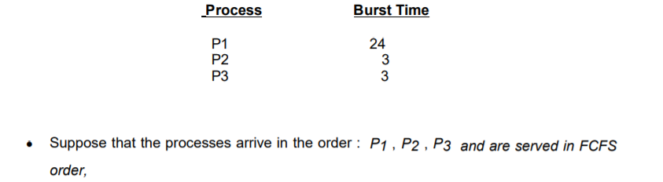
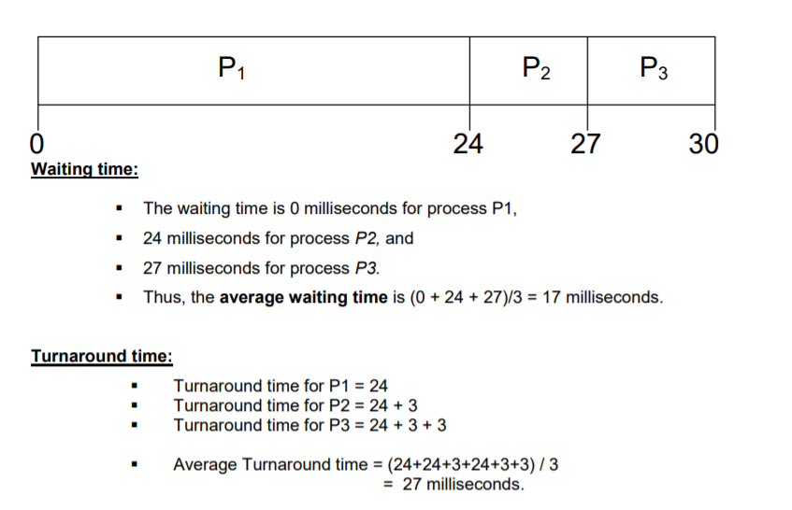
Example 1:

Slide 8
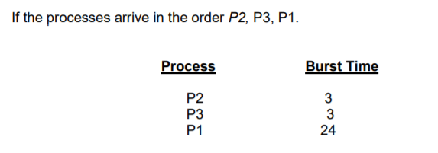
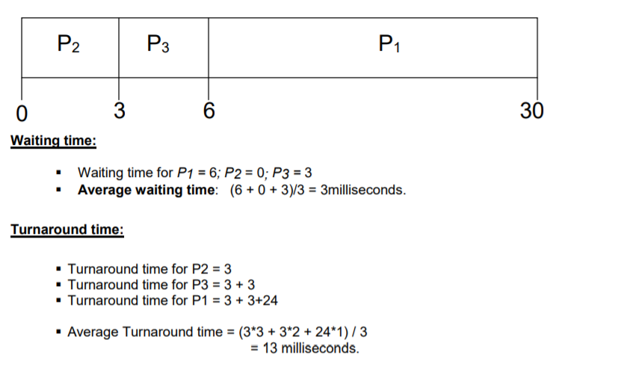
Example 2:

Slide 9
FCFS….contd..,
Once the CPU has been allocated to a process, that process keeps the CPU until it releases the CPU, either by terminating or by requesting I/O.
The FCFS algorithm is thus particularly troublesome for time-sharing systems, where it is important that each user get a share of the CPU at regular intervals. It would be disastrous to allow one process to keep the CPU for an extended period.

Slide 10
Shortest-Job-First scheduling
This algorithm associates with each process the length of the process's next CPU burst.
When the CPU is available, it is assigned to the process that has the smallest next CPU burst.
If the next CPU bursts of two processes are the same, FCFS scheduling is used to break the tie.
Moving a short process before a long one decreases the waiting time of the short process more than it increases the waiting time of the long process.
Consequently, the average waiting time decreases

Slide 11
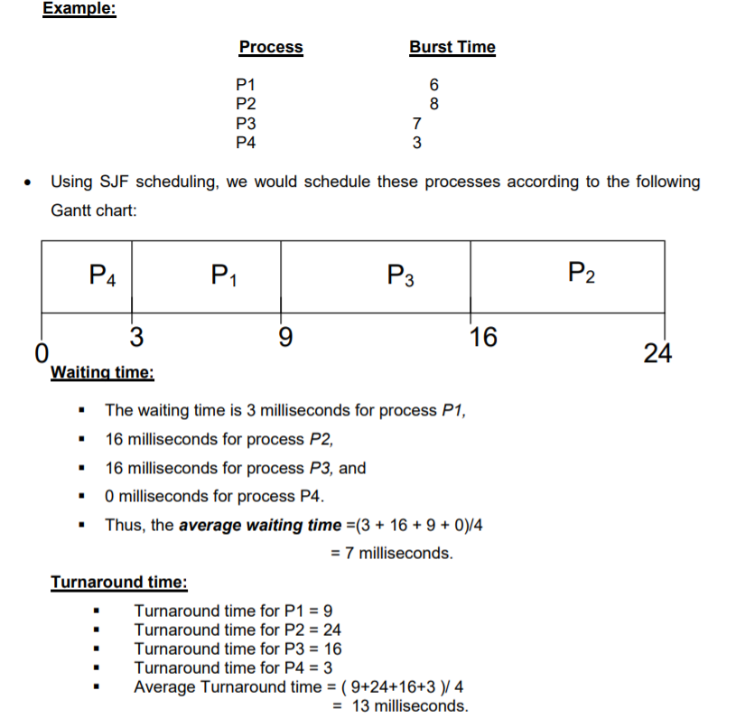

Slide 12
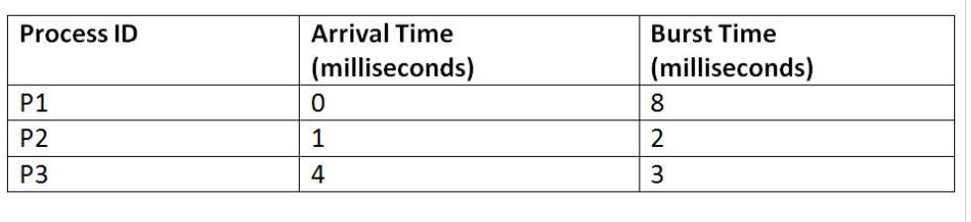
Shortest- Remaining-Time- First
The preemptive version of the SJF scheduling algorithm.
The process which has the least processing time remaining is executed first.
As it is a preemptive type of schedule, it is claimed to be better than SJF scheduling Algorithm.

Slide 13
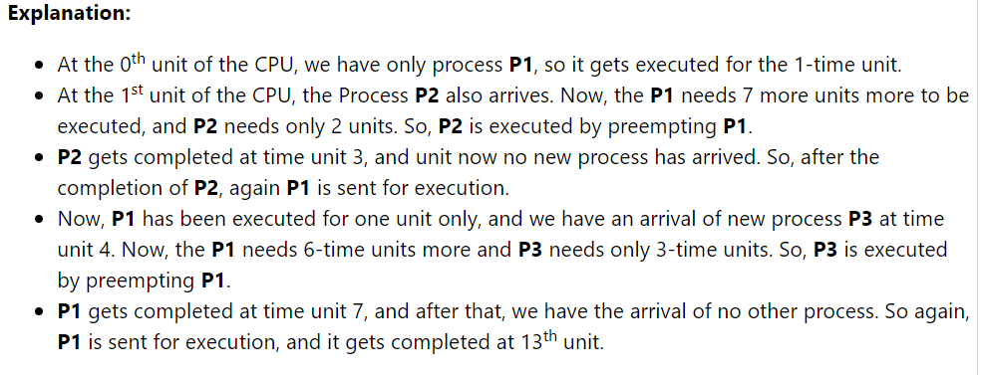
P1 | P2 | P1 | P3 | P1
0
1
3
4
7
13

Slide 14
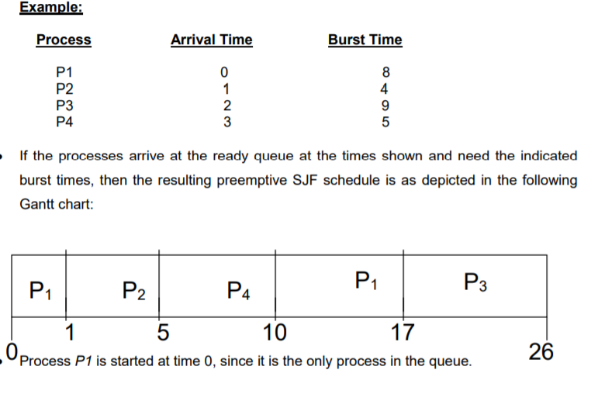
Shortest- Remaining-Time- First
Preemptive SJF scheduling is sometimes called shortest-remaining-time-first scheduling.

Slide 15
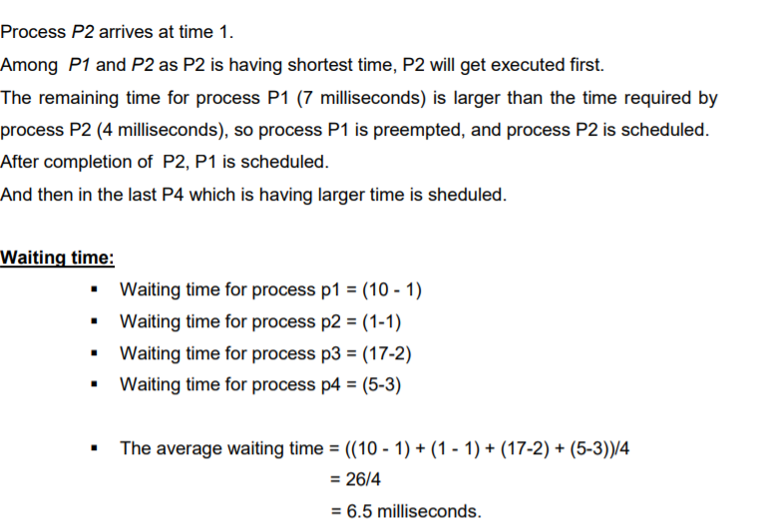

Slide 16
Priority scheduling
A priority is associated with each process, and the CPU is allocated to the process with the highest priority.
Equal-priority processes are scheduled in FCFS order.
Priorities are generally indicated by some fixed range of numbers, such as 0 to 7 or 0 to 4,095.
There is no general agreement on whether 0 is the highest or lowest priority.
Some systems use low numbers to represent low priority; others use low numbers for high priority. Here, we assume that low numbers represent high priority.

Slide 17
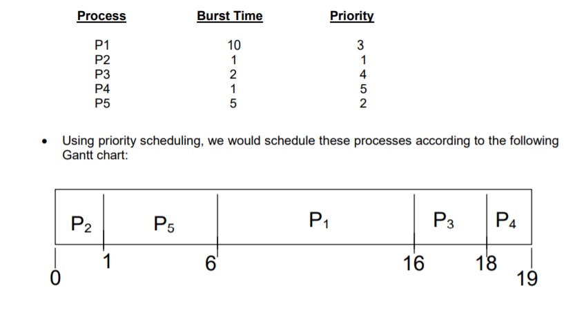
EXAMPLE
Process P2 is started at time 0, since it is having the highest priority among the processes in the queue. After execution of P2 process, process P5 is started at time 1. Then P1,P3 and P4 as P2 processes are executed. is having shortest time, P2 will get executed first.

Slide 18
Contd..,
Waiting time:
Waiting time for process p1 = 6
Waiting time for process p2 = 0
Waiting time for process p3 = 16
Waiting time for process p4 = 18
Waiting time for process p5 = 1
The average waiting time = (6+0+16+18+1)/5 = 41/5 = 8.2 milliseconds

Slide 19
Contd..,
Turnaround time:
Turnaround time for P1 = 6 + 10
Turnaround time for P2 = 0 + 1
Turnaround time for P3 = 16 + 2
Turnaround time for P4 = 18 + 1
Turnaround time for P5 = 1 + 5
Average Turnaround time = (16+1+18+19+6) / 5 = 12 milliseconds

Slide 20
Priority scheduling
Priority scheduling can be either preemptive or nonpreemptive.
When a process arrives at the ready queue, its priority is compared with the priority of the currently running process.
A preemptive priority scheduling algorithm will preempt the CPU if the priority of the newly arrived process is higher than the priority of the currently running process.
A nonpreemptive priority scheduling algorithm will simply put the new process at the head of the ready queue.
Disadv:
indefinite blocking, or starvation.

Slide 21
Solution- Aging
A process that is ready to run but waiting for the CPU can be considered blocked.
A priority scheduling algorithm can leave some low priority processes waiting indefinitely.
In a heavily loaded computer system, a steady stream of higher-priority processes can prevent a low-priority process from ever getting the CPU.
Aging is a technique of gradually increasing the priority of processes that wait in the system for a long time. • For example, if priorities range from 127 (low) to 0 (high), we could increase the priority of a waiting process by 1 every 15 minutes.

Slide 22
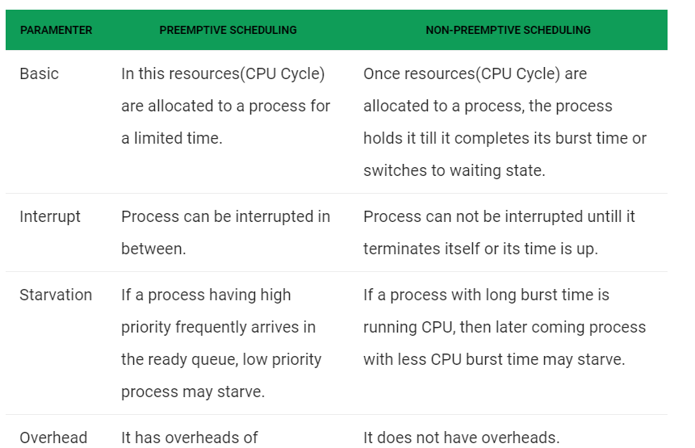

Slide 23
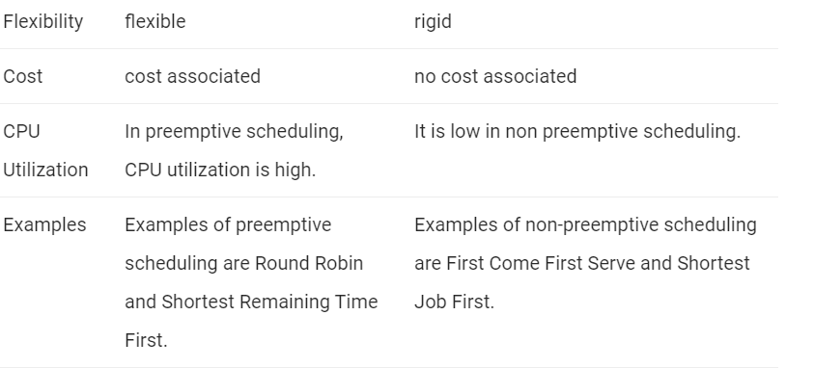
Conti..

Slide 24
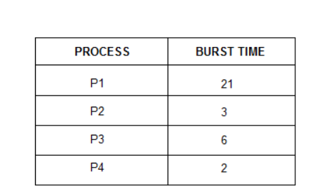

Slide 25
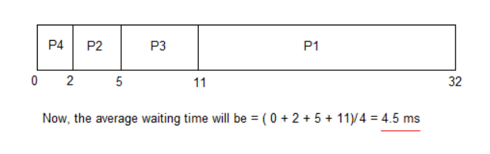

Slide 26
Round-Robin Scheduling
In Round-robin scheduling, each ready task runs turn by turn only in a cyclic queue for a limited time slice.
Characteristics of Round-Robin Scheduling
Round robin is a pre-emptive algorithm
The CPU is shifted to the next process after fixed interval time, which is called time quantum/time slice.
The process that is preempted is added to the end of the queue.

Slide 27
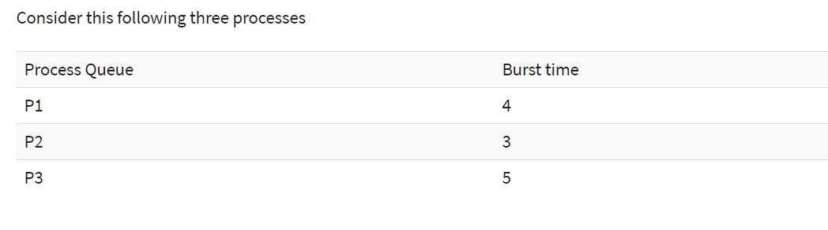
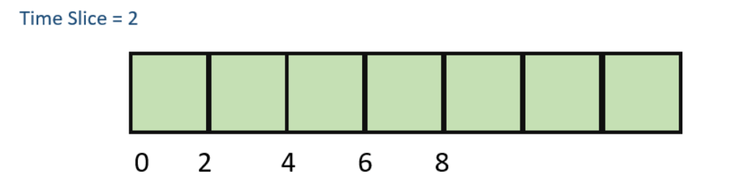
P3 | P2 | P1
Ready Queue

Slide 28
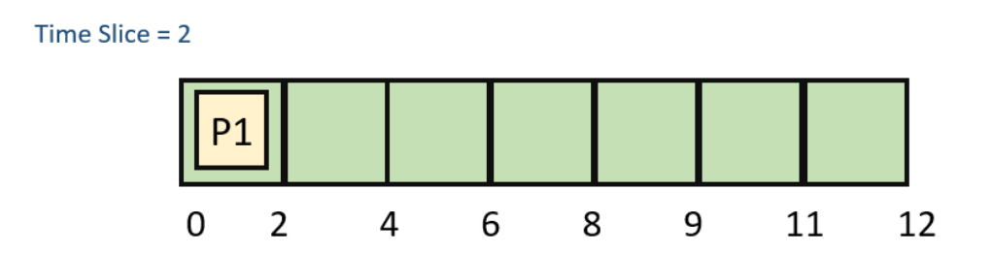
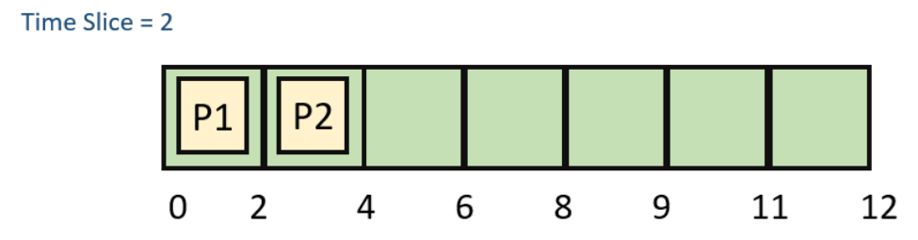
Step 1) The execution begins with process P1, which has burst time 4. Here, every process executes for 2 seconds. P2 and P3 are still in the waiting queue.
Step 2) At time =2, P1 is added to the end of the Queue and P2 starts executing
P1 | P3
Ready Queue

Slide 29
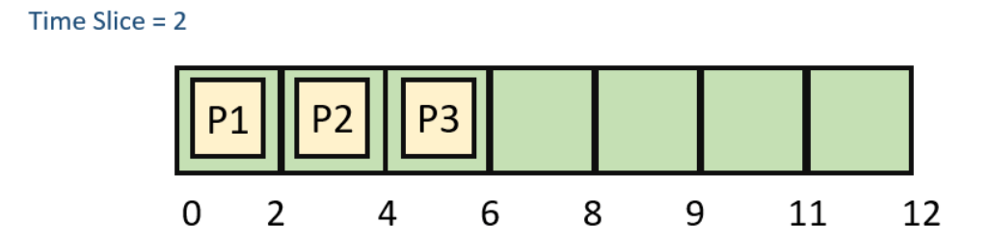
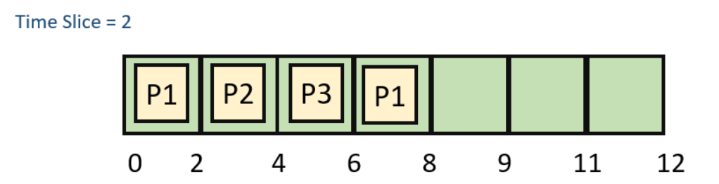
Step 3) At time=4 , P2 is preempted and add at the end of the queue. P3 starts executing.
P2 | P1
Step 4) At time=6 , P3 is preempted and add at the end of the queue. P1 starts executing.
P3 | P2

Slide 30
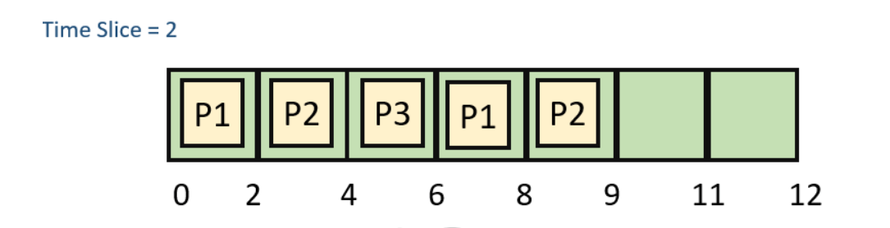
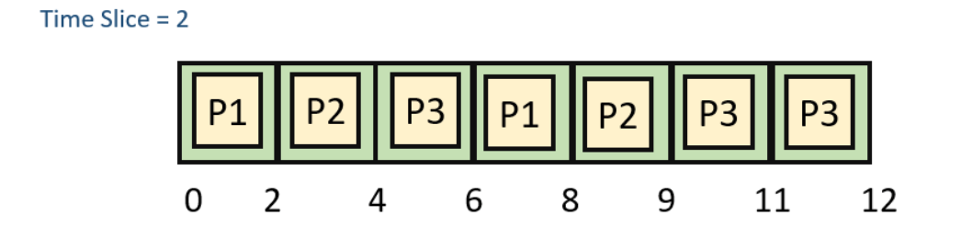
Waiting time
P1= 0+ 4= 4
P2= 2+4= 6
P3= 4+3= 7

Slide 31
Advantage of Round-robin Scheduling
It doesn't face the issues of starvation or convoy effect.
All the jobs get a fair allocation of CPU.
It deals with all process without any priority
Disadvantages of Round-robin Scheduling
This method spends more time on context switching
Its performance heavily depends on time quantum.
Priorities cannot be set for the processes.
Round-robin scheduling doesn't give special priority to more important tasks.

Slide 32
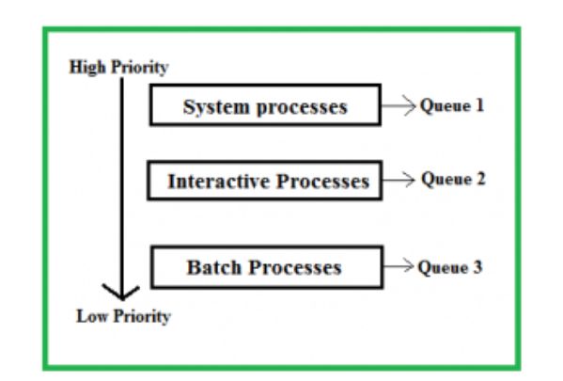
Multilevel Queue Scheduling
Processes in the ready queue can be divided into different classes where each class has its own scheduling needs.
For example, a common division is a foreground (interactive) process and background (batch) processes.These two classes have different scheduling needs.

Slide 33
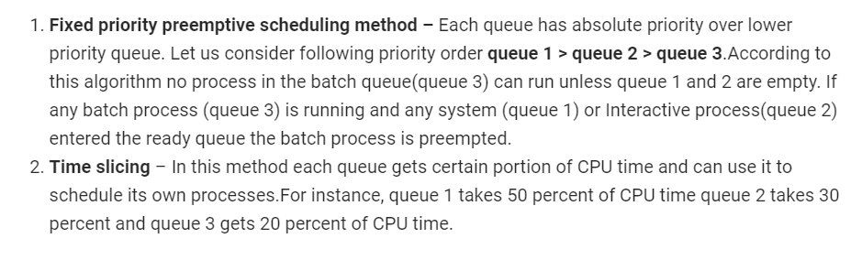
Scheduling among the queues

Slide 34
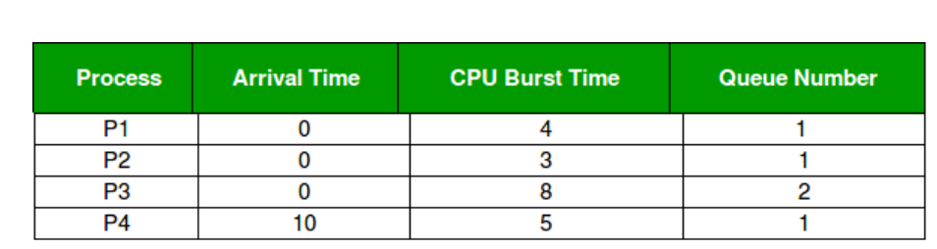
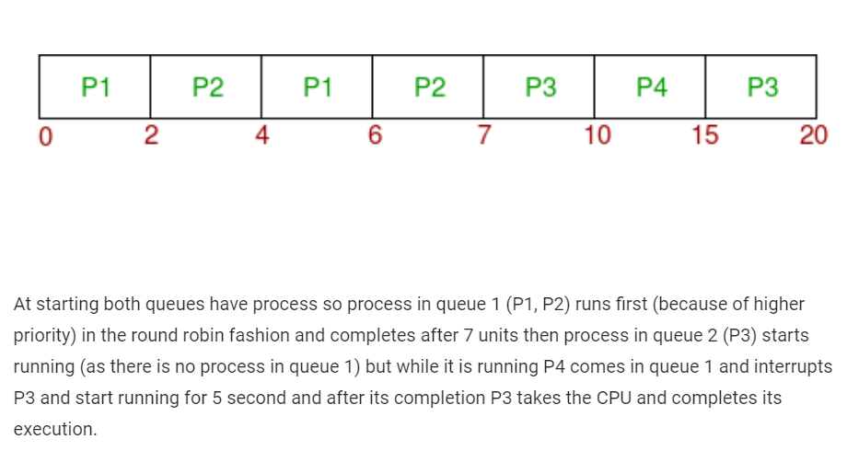
Priority of queue 1 is greater than queue 2. queue 1 uses Round Robin (Time Quantum = 2) and queue 2 uses FCFS.

Slide 35
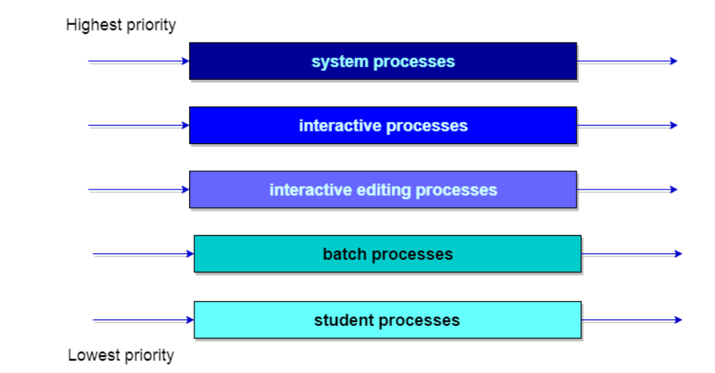
Example

Slide 36
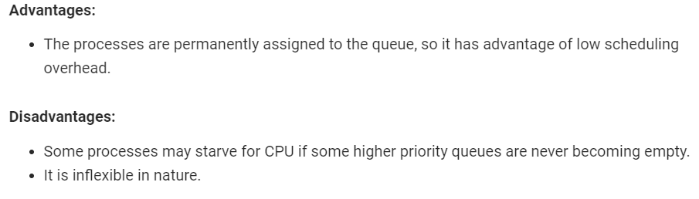

Slide 37
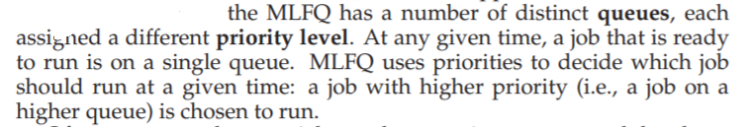
Multilevel Feedback Queue Scheduling
Allows a process to move between queues. The idea is to separate processes with different CPU-burst characteristics.
If a process uses too much CPU time, it will be moved to a lower-priority queue.
Similarly, a process that waits too long in a lower-priority queue may be moved to a higher-priority queue.
This form of aging prevents Starvation.

Slide 38
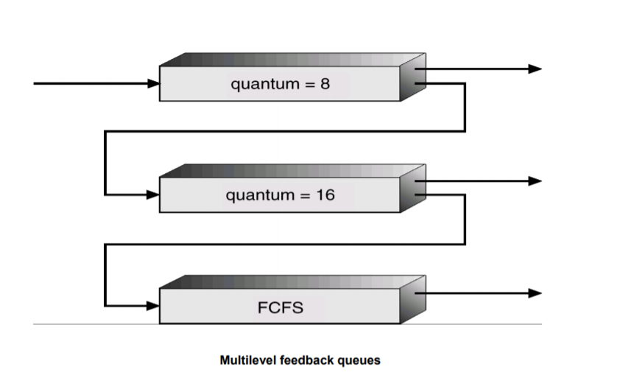
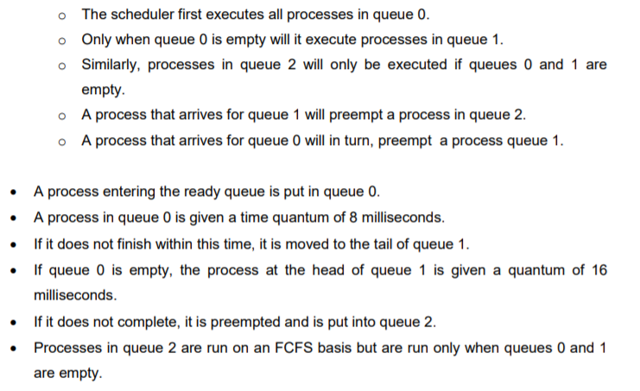

Slide 39
Parameters
In general, a multilevel feedback-queue scheduler is defined by the following parameters:
The number of queues
The scheduling algorithm for each queue
The method used to determine when to upgrade a process to a higher priority queue
The method used to determine when to demote a process to a lower priority queue
The method used to determine which queue a process will enter when that process needs service

Slide 40
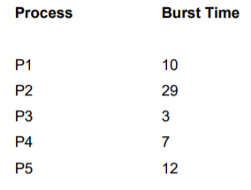
Algorithm Evaluation
• Maximizing CPU utilization under the constraint that the maximum response time is 1 second
• Maximizing throughput such that turnaround time is (on average) linearly proportional to total execution time
Deterministic Modeling
Consider the FCFS, SJF, and RR (quantum = 10 milliseconds) scheduling algorithms for this set of processes. Which algorithm would give the minimum average waiting time?

Slide 41
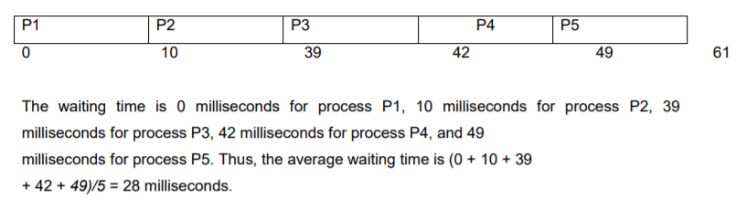
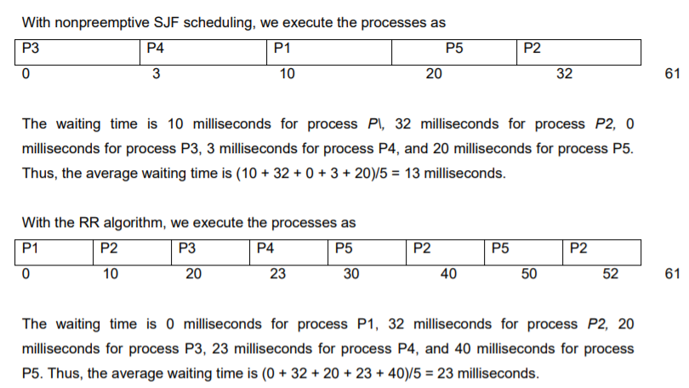

Slide 42
Algorithm Evaluation(contd..,)
2. Queueing Models
a queuing model is used to approximate a real queuing situation or system, so the queuing behavior can be analyzed mathematically. Queuing models allow a number of useful steady state performance measures to be determined, including:
The Average number in the queue, or the system, the average time spent in the queue, or the system, the statistical distribution of those numbers or times, the probability the queue is full, or empty, and the probability of finding the system in a particular state.

Slide 43
Contd..,
As an example, let n be the average queue length (excluding the process being serviced), let W be the average waiting time in the queue, and let X be the average arrival rate for new processes in the queue (such as three processes per second).
During the time W that a process waits, X new processes will arrive in the queue.
If the system is in a steady state, then the number of processes leaving the queue must be equal to the number of processes that arrive.
Thus, this equation n= XxW known as Little's formula, is particularly useful because it is valid for any scheduling algorithm and arrival distribution

Slide 44
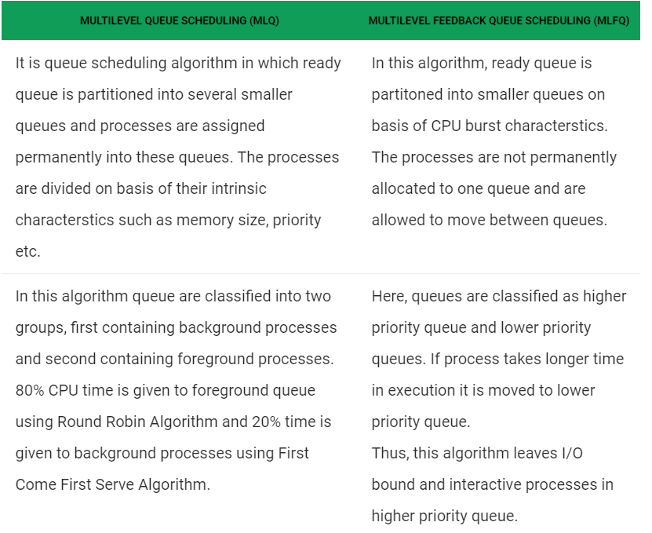

Slide 45
